Slide 1
Sprint 0
Noah Baker, Sophie Fischer, Noah Monroe, and Gavin Strickland

Slide 2
Goals for Sprint zero
Select Scrum Master, team name, project
Set up project tracking, team communication
Get to know each other! (Strengths/ weaknesses, etc.)
Set up software
Develop Scrum user stories, prototype login screen

Slide 3
Accomplished Tasks
Elected a SCRUM Master, designated front and back end, and decided on a team name
SCRUM Master – Sophie
Team name – Butler University Development Squad (B.U.D.S.)
Gavin and Noah Monroe – Back end, Sophie and Noah Baker – Front end
Selected our project for the semester
Work-Flow Management System – Design a system to manage incoming and outgoing products from each department and generating reports
Set up a system for project tracking
Trello Board has been set up and used to track requirements of the project
Set up a system and norms for team communication
Primarily communicating by text message – can also communicate by email
Developing Scrum User Stories for each requirement

Slide 4
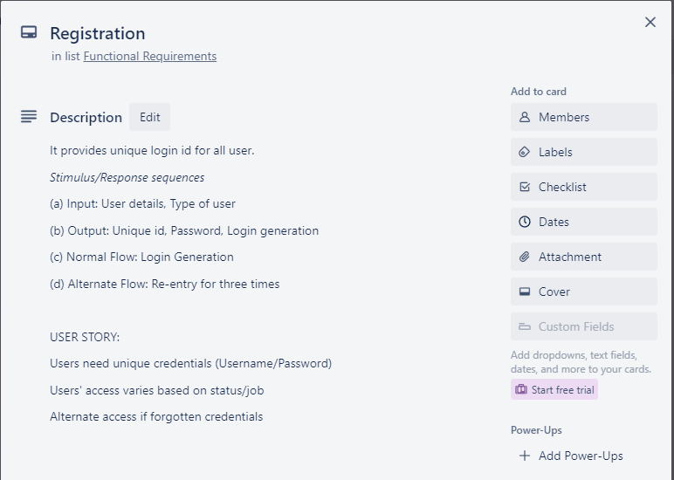
User stories
Using Trello, we separate function requirements into unique "cards"
Cards include general description
Requirements needed to complete task
User story

Slide 5
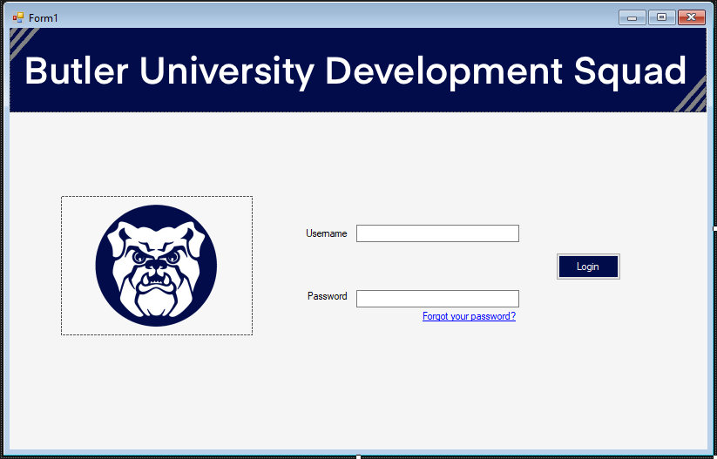
GuI Login screen – rough draft

Slide 6
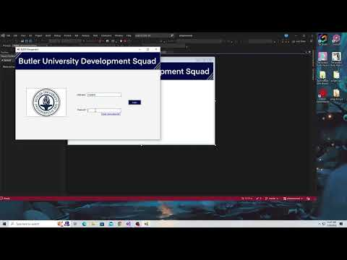
GUI DEmo

Slide 7
Challenges
Collaborative Software Setup
Working with GitHub/ ability to see everyone's changes

Slide 8
Next Steps
Learn C# and begin software development
Continue working on GUI login screen
Learn Adobe XD
Implement database to store login information
Learn how to setup Azure SQL database

Slide 9

Questions?

